Slide 1
INCLUVISION
Incluvision is a first of its kind initiative by a school, it is a comprehensive biannual magazine catering exclusively to the people of determination.
The magazine will be a platform to recognize and showcase Determined Ones talents. It will be an authentic source of recent research and relevant information to help serve the UAE’s Determined Ones community. Reading the stories, learning about struggles and successes of families with Determined Ones can be inspiring, engaging and will foster a sense of support and inclusion in the Determined Ones community. It will also help bring change in public perception on disability.
It’s a matter of great pride for us that Incluvision has been appreciated by all the stakeholders of determined ones community. We were fortunate to have Fatma Belrehif - Executive Director, DSIB to unveil the magazine and write a welcome note for the first edition. In a small journey of 2 yrs. we have published 4 editions of Incluvision. Some of the notable contributors for our magazine are Mr. Gareth D. Morewood and Mr. David Bartram from U.K., Ms. Emma Dibden from JESS, Prof. Emaan Gaad from BUID. With well wishers and great supporters like Dr. Sonakshi Sinha from Amity University, Ms. Safia Bari from SNF, Dr. Alka Kalra from Eduscan we hope to live a dream of reaching out to the Determined Ones community of UAE with the message “Empathize Educate Empower”

Slide 2
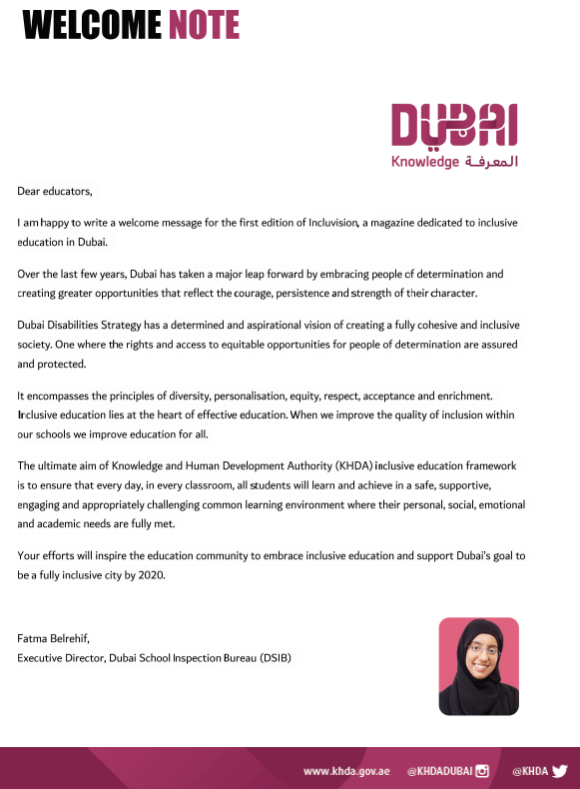

Slide 3
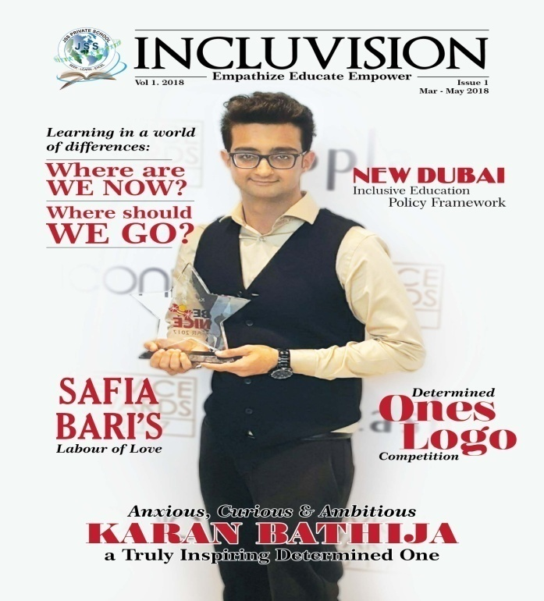

Slide 4
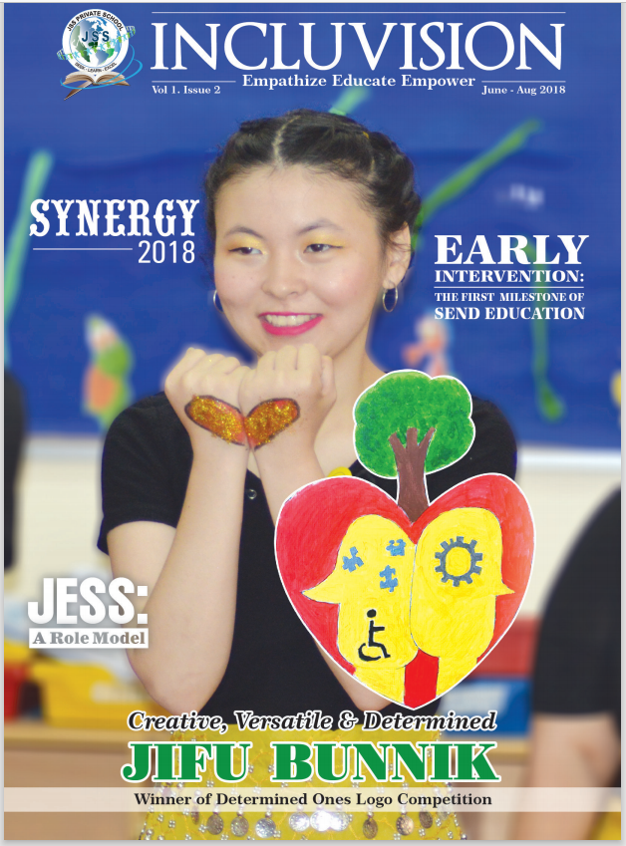

Slide 5
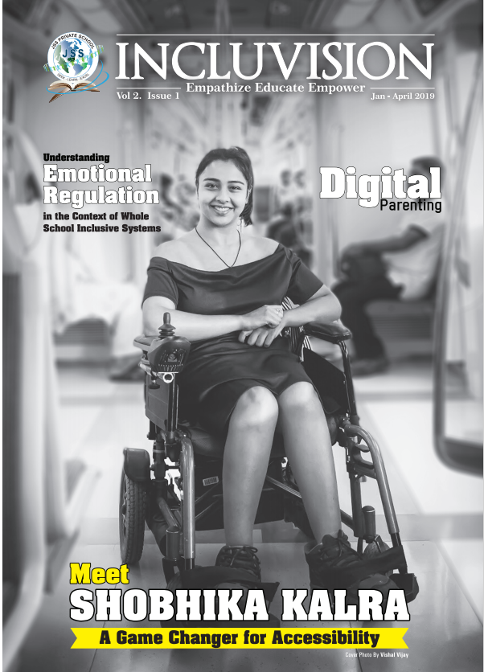

Slide 6
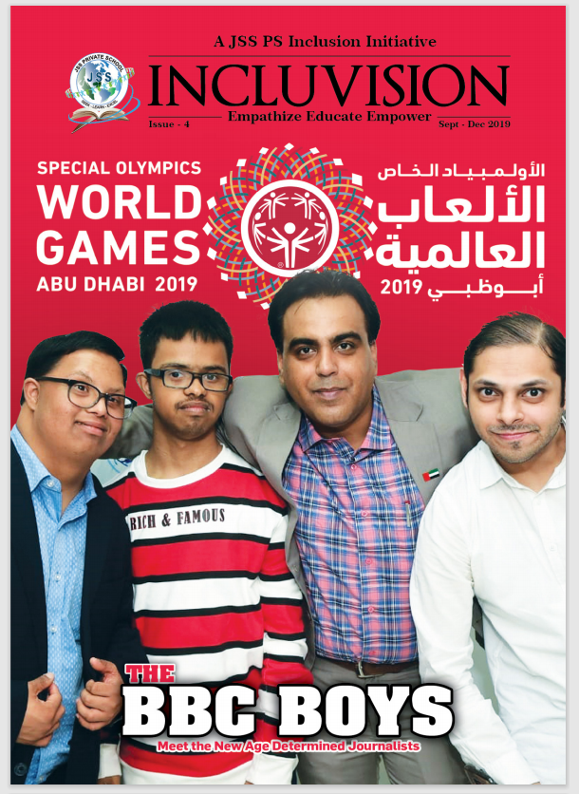

Slide 7

Coming Soon
Next Edition
“Inclusion & Well-Being in 2020:
New Realities, New Beginnings”

Slide 8
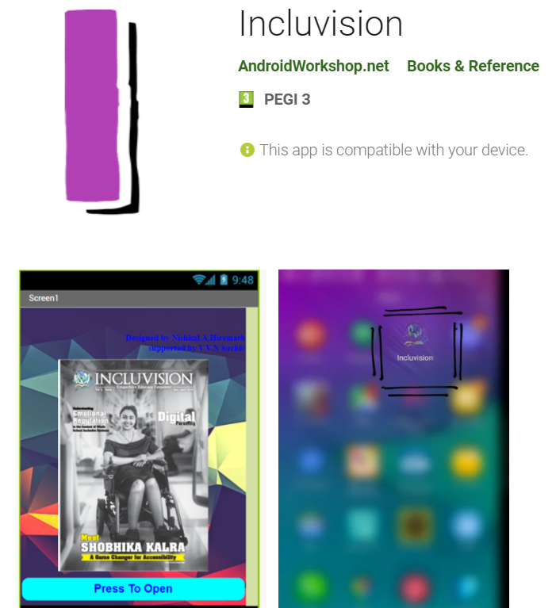
Also available on Play Store and soon on App Store
The Link for Play Store
https://play.google.com/store/apps/details?id=appinventor.ai_nishkal2002h.Incluvision

